Slide 1

PMD Material Data Set 42CrMoS4
Process Schema
  —
    M. Luke, 04.12.2025

Slide 2
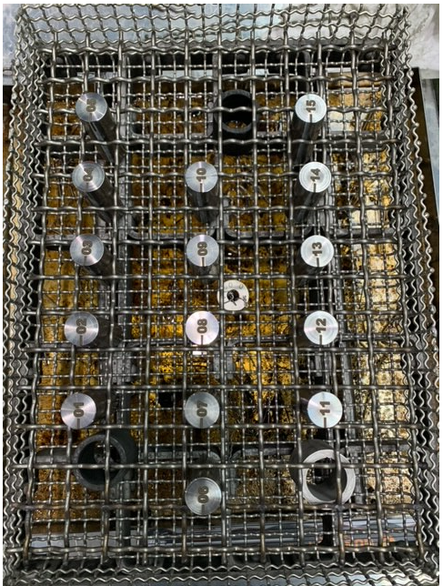

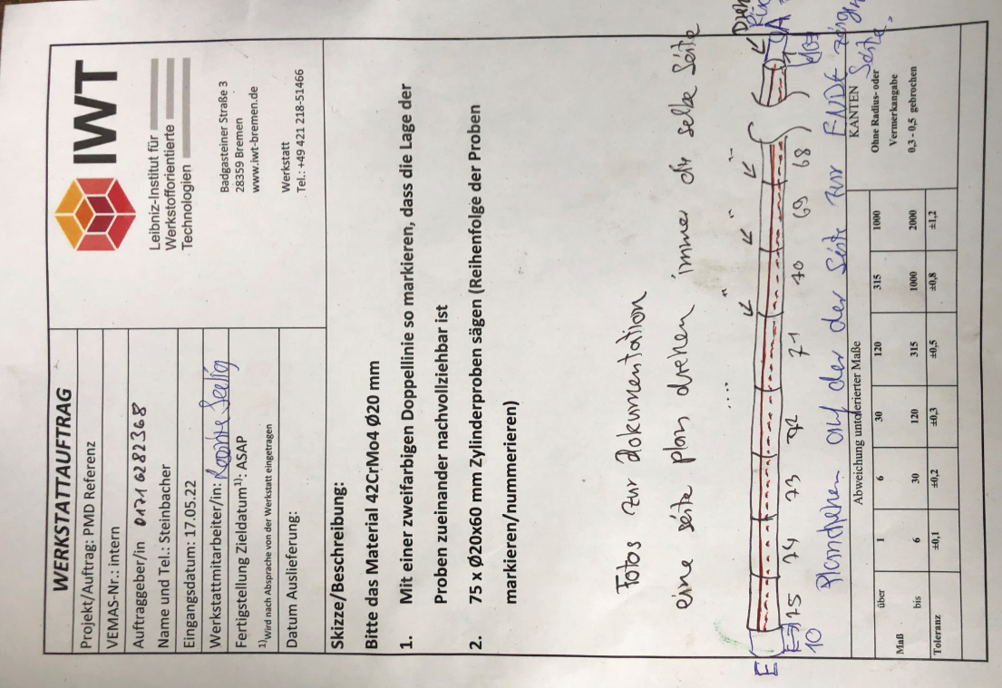
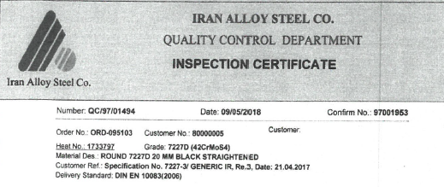
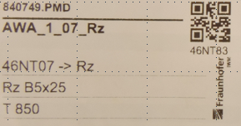
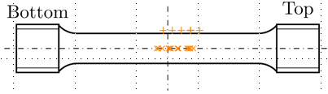

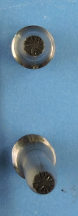

PMD Material Data Set
Material batches:
  T 850 → Charge 3466
  T 925 → Charge 3467
  T 1000 → Charge 3468
  T 1150 → Charge 3470
  T 1075 → Charge 3471
70 bars
ID= 1,2, …
IWT-Label
Heat treated bars:
Hardened and tempered
Shipping
(IWT2IWM)
      Process Schema
Heat Treatment
(IWT)
…
Separated bars
ID=1,2, …
…
…
IWT-Label
5 material batches!
Kept by IWT
IWM-Label
Separation
(IWT)
ID=1,2, …
Hot rolled piece
Separation
(IWM)
1 bar= 1 tensile specimen+1 metallographic specimen
70 tensile test specimens
IRAN-Steel: 42CrMoS4
Quenched and tempered
Spectroscopy
(IWT)
kept as
reference
IWM-Label
…
70 metallographic specimens
Met. sample
IWM-Label
Hardness measurement
HV 1 (IWM)
Hardness measurement HV 10 (IWM)
IWM-Label
LiMi+Grain size evaluation
(IWM)
IWM-Label
Metallographic preparation (IWM)
Met. sample
Met. sample
Met. sample
Polished again
Roughness measurements
(IWM)
Block to be digitalized by IWT!
IWM-Label
Hardness measurement
HV 10 (IWT)
Grain size measurement (IWT)
Separation
(IWT)
Shipping (IWM2IWT)
Met. sample
Met. sample
70
Tensile test
(IWM)
70
IWM-Label
Notes:
HeatTreatment: position in oven attached via picture file
Hardening and tempering modelled in two separated graphs

